Slide 1
Process Management
Prepared by:-
Shrey P. Bechara
GID:-
158312

Slide 2
What is Process?
Program in execution is termed as process.

Slide 3
What is Threads?
Process
Unit of execution within a process is termed as threads.
A process can have one thread or multiple threads.
Threads

Slide 4
Process state
As a process executes, it changes state.
State of a process is defined by the current activity a process is doing.

Slide 5
Each Process are in one of a following state
New:- The process is being created.
Running:- Instruction are being executed.
Waiting:- The process is waiting for some event to occur(Such as an I/O completion or reception of a signal)
Ready:-The process is waiting to be assigned to a processor.
Terminated:- The process has finished execution.

Slide 6
New
Terminated
Admitted
Exit
Interrupts
Ready
Running
Schedular dispatch
I/O or Event Completion
I/O or Event
Waiting

Slide 7
Process Control Block
Each process is represented in an OS by Process Control Block(PCB) or Task Control Block

Slide 8
PCB
Process ID
Process State
Program Counter
CPU Register
CPU Scheduling information
Memory Management Information
Accounting Information
I/O Status Information

Slide 9
Process Scheduling
The objective of a multiprogramming is that to run some set of program continuously to maximize a CPU utilization.
The objective of a time sharing is to switch a CPU among processes so frequently that user can interact with each program while it is running.
To meet above objectives, process schedular selects an available process(possibly from a set of several available processes) for program execution on the CPU.
For a single processor system, there will never be more than one running process.
If there are multiple processes, they must wait until the CPU is free and can be rescheduled.

Slide 10
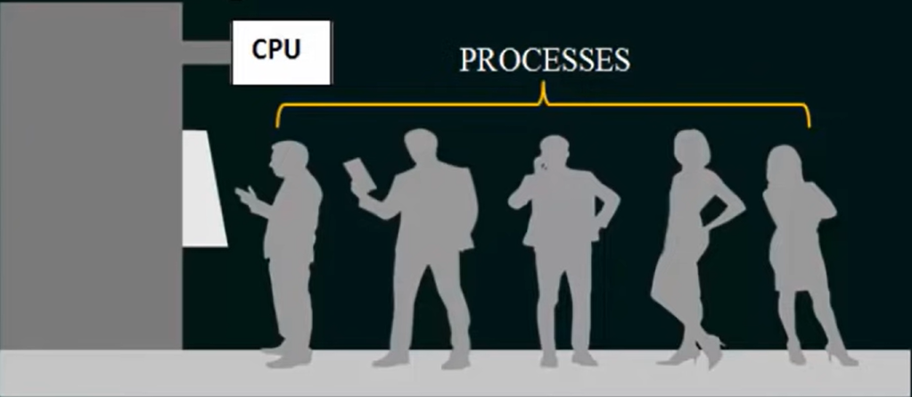
Scheduling Queues
Job Queue:- As processes enter a system, they are put into a job queue, which consist of all processes in the system.
Ready Queue:- The processes that are residing in a main memory and are ready and waiting to execute are kept on a list called ready queue.

Slide 11
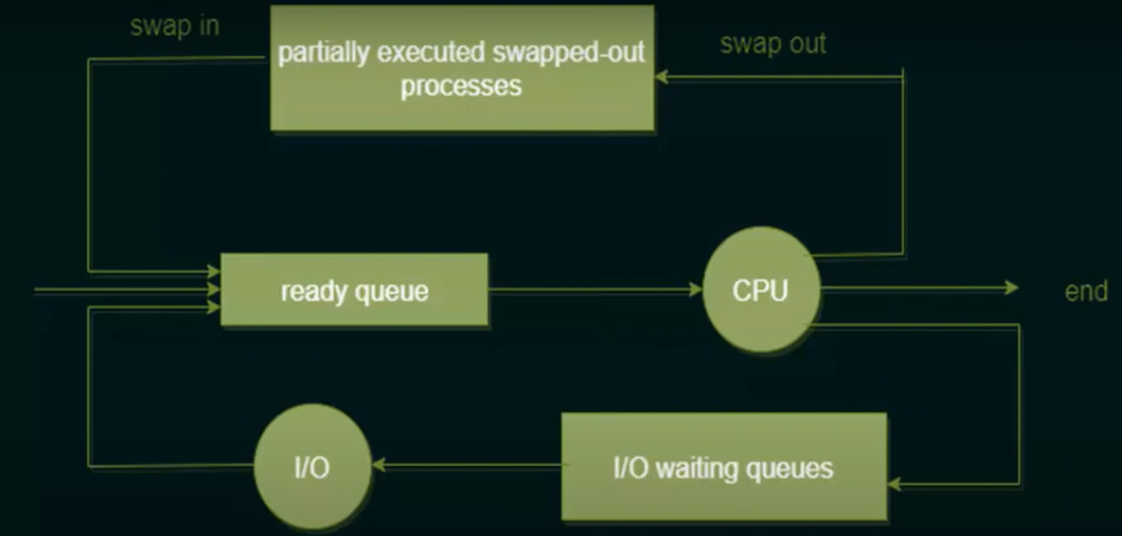

Slide 12
Types of schedular
Round Robin Scheduling :-What is time Quantum? What is turn around time? What is waiting time?
Complete Fair Scheduling

Slide 13
Context Switch
Interrupts cause the OS to change a CPU from its current task and to run a kernel routine.
Such operation happens frequently in general purpose computers.
When Interrupts occurs, the system needs to save the CONTEXT of process currently running so that it can restore that context when its processing is done, essentially suspending the process and then resuming it.
The context is represented in PCB of the process.
Switching the CPU to another process requires to save the context of process currently running and restore it back when high priority task is performed.
Context switch = Save Context + Restore context.

Slide 14
Few points regarding context switching
Context switch time is pure overhead i.e. while context switching CPU doesn’t do any useful work.
Context switch time varies from machine to machine.
Typical speeds are few milliseconds.

Slide 15
Process Creation
A process may create several new processes.
Creating process is called a parent process, and new processes are called children of that process.
When a process creates a new process, two possibilities exist in terms of execution:
The parent continues to execute concurrently with its children.
The parent waits until some or all of its children have terminated.

Slide 16
There are also two possibilities in terms of the address space of the new process:
The child process is a duplicate of the parent process(it has the same program and data as the parent).
The child process has a new program loaded into it.

Slide 17
Inter Process Communication
There are different types of IPCs:
Pipe
FIFO
Message Queue
Shared Memory

Slide 18
Process Synchronization
Semaphores
Mutex Lock

